Slide 1

MATH 4P81 Final Project Presentation
Topic: Points Scored By Teams in the March Madness Tournament
By: Raymond Romaniuk

Slide 2
Introduction
Research Question:
  Which sampling method best estimates the amount of points scored in a March Madness game?
    Simple Random Sample Without Replacement
    Stratified Random Sample with Proportional Allocation
    Stratified Random Sample with Neyman Allocation
Main Findings:
  Stratified Random Sample with Neyman Allocation seemed to be the best method for our purpose
    Had the lowest variance and standard error of the estimator and closest standard deviation to the population
Importance:
  A good estimation of how many points will be scored allows a coach to prepare his team to score more than that and be as successful as possible

Slide 3

Data
Sources of Data:
  Data acquired from a personal web scraping project
    Sources: ESPN, Fox Sports, the NCAA and the Pomeroy College Basketball Ratings
  Only using points scored and seeding information
  Two datapoints for each game
    67 games per tournament, 2 tournaments, 2 observations for each game, 268 total observations in the population

Slide 4
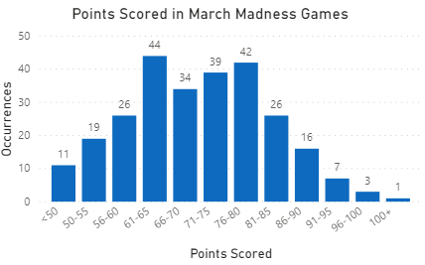
Population Characteristics
Wide range of points scored
  Top teams from weak conferences are weaker than mid level teams from top conferences
Mean = 70.3545
Standard Deviation = 11.9216

Slide 5
Sample Factors
Schools athletic director believes most recent tournaments are best for our sampling
  The sampling frame is all games from the past two tournaments

Slide 6
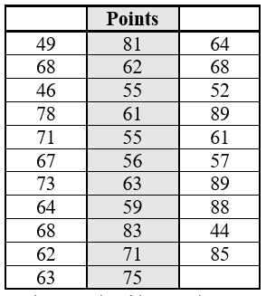
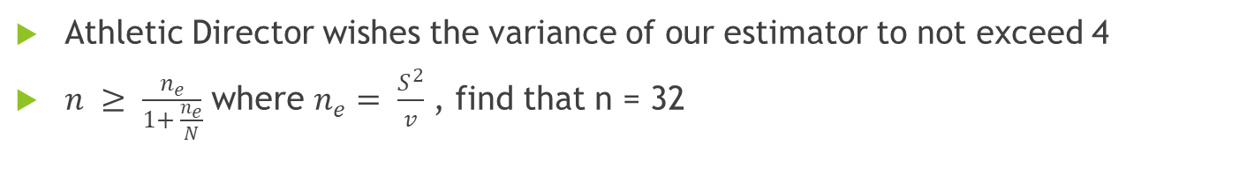
Sampling Methods
Simple Random Sample Without Replacement
Athletic Director wishes the variance of our estimator to not exceed 4
$n ≥ \frac{n_{e}}{1+ \frac{n_{e}}{N}}$ where $n_{e}= \frac{S^{2}}{v}$ , find that n = 32

Slide 7
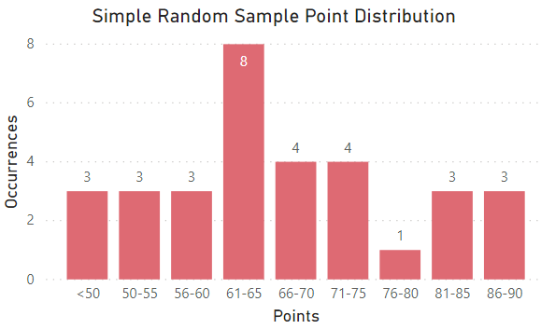
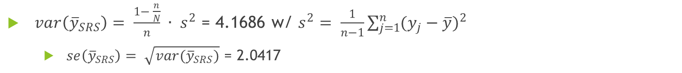
Sampling Methods
Simple Random Sampling Without Replacement II
Random Sample Characteristics:
  Mean = 66.46875
  Standard Deviation = 12.3078
Shapiro-Wilk Test for normality
  p = 0.379 > 0.05, data follows Normal Distribution w/ 95% confidence
$var\left({\overline{y}}_{SRS}\right)= \frac{1− \frac{n}{N}}{n} ∙ s^{2}$ = 4.1686 w/ $s^{2}= \frac{1}{n−1}\sum_{j=1}^{n}{{(y_{j}−\overline{y})}^{2}}$
  $se\left({\overline{y}}_{SRS}\right)= \sqrt{var({\overline{y}}_{SRS})}$ = 2.0417

Slide 8
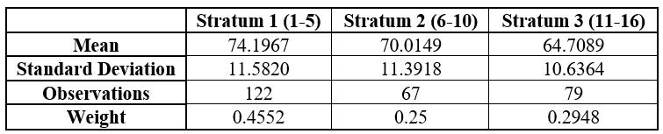
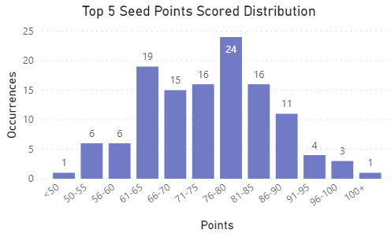
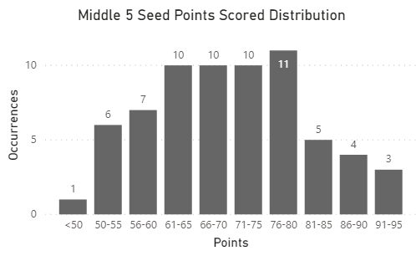
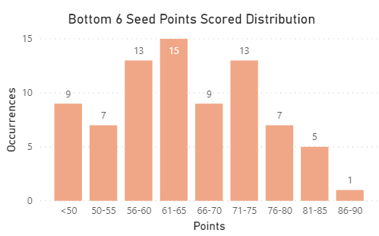
Sampling Methods II
Stratified Random Sample w/ Proportional Allocation
Use n = 32 for comparison to SRS
Data divided into three stratum by seed of team (1-5, 6-10, 11-16)

Slide 9
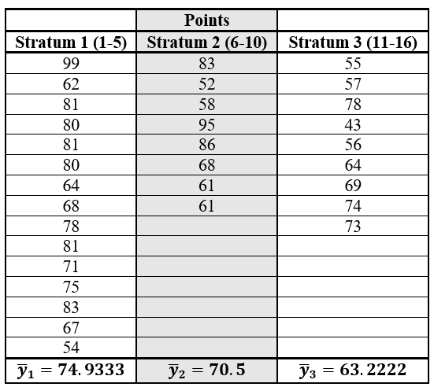
Sampling Methods II
Stratified Random Sample w/ Proportional Allocation II
Calculate number of observations from each stratum multiply n = 32 by each stratum weight
  Obtain n = 15, 8 and 9 for Stratum 1, 2 and 3
Draw the following sample:

Slide 10
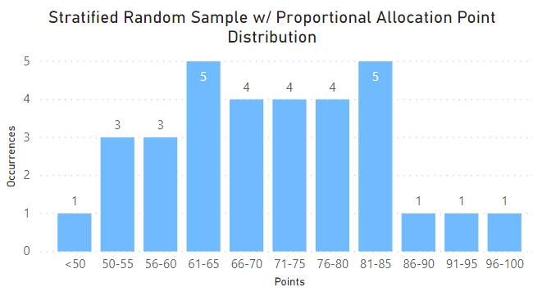
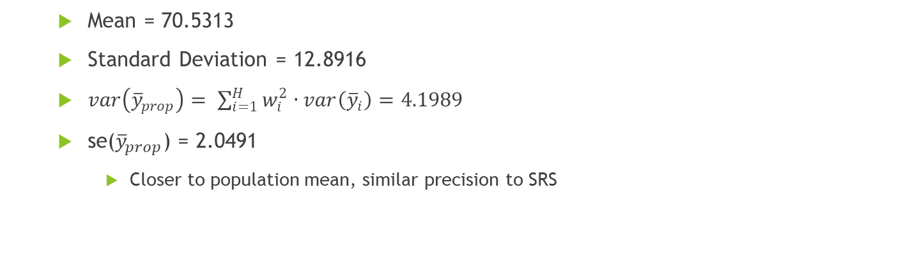
Sampling Methods II
Stratified Random Sample w/ Proportional Allocation III
  Mean = 70.5313
  Standard Deviation = 12.8916
  $var\left({\overline{y}}_{prop}\right)= \sum_{i=1}^{H}{w_{i}^{2}}∙var\left({\overline{y}}_{i}\right)=4.1989$
  se(${\overline{y}}_{prop}$) = 2.0491
    Closer to population mean, similar precision to SRS

Slide 11
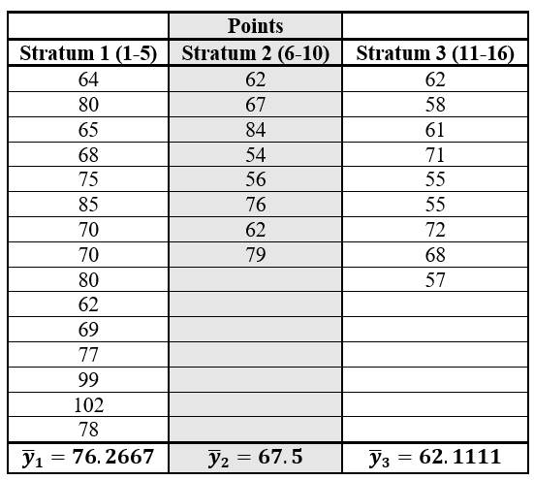
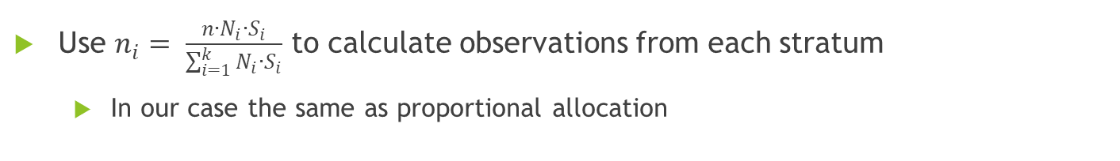
Sampling Methods III
Stratified Random Sample w/ Neyman Allocation
Use $n_{i}= \frac{n∙N_{i}∙S_{i}}{\sum_{i=1}^{k}{N_{i}∙S_{i}}}$ to calculate observations from each stratum
  In our case the same as proportional allocation
Select the following sample:

Slide 12
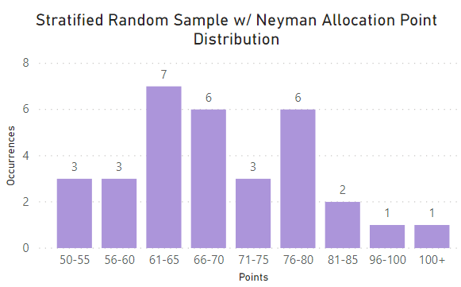
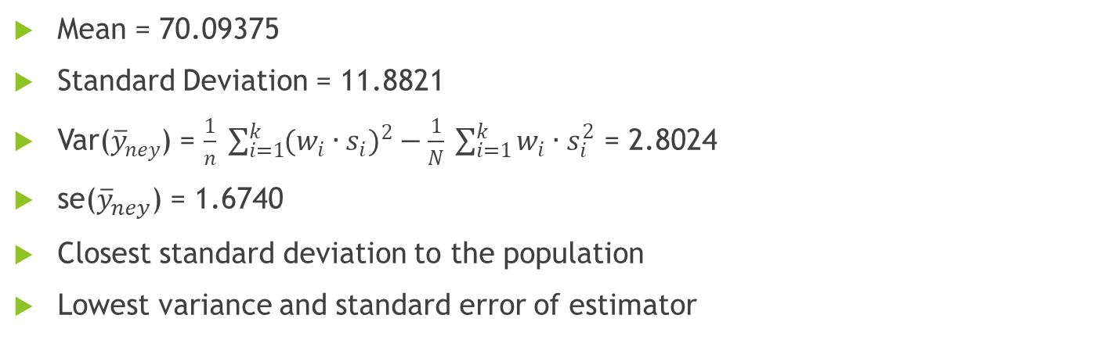
Sampling Methods III
Stratified Random Sample w/ Neyman Allocation II
Mean = 70.09375
Standard Deviation = 11.8821
Var(${\overline{y}}_{ney}$) = $\frac{1}{n} \sum_{i=1}^{k}{{(w_{i}∙s_{i})}^{2}}−\frac{1}{N} \sum_{i=1}^{k}{w_{i}∙s_{i}^{2}}$ = 2.8024
se(${\overline{y}}_{ney}$) = 1.6740
Closest standard deviation to the population
Lowest variance and standard error of estimator

Slide 13
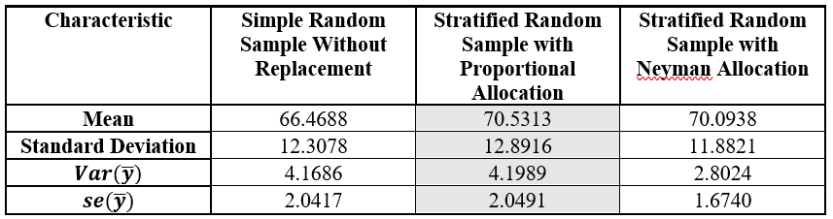
Conclusion
Stratified Random Sample w/ Neyman Allocation seemed to perform the best
Notably both Stratified Random Samples used the same number of observations per strata
  Difference in samples or is Neyman Allocation more suitable?

